Slide 1


ALZHEIMER’S DISEASE PREDICTION
DSCI 6612 – 01
INTRODUCTION TO ARTIFICIAL INTELLIGENCE
Professor: Vahid Behzadan
Submitted by
Omkar Avinash Durgasi
Sai Ram Lohith Nalluri

Slide 2
Introduction
Alzheimer's usually starts after age 60. The risk increases as the person ages. The risk of having this disease is greater if there are people in the family who have had this disease. As for the treatments that have been done for this disease, there is none that can stop the progress of this. So far what these treatments can achieve is to help alleviate some symptoms, reducing their intensity and contributing to a higher quality of life for patients and their families. Implementation of classification algorithms for the analysis of the medical dataset, in order to provide a prediction tool for the early diagnosis of the disease.
Symptoms:
Taking more time to perform a regular task than the normal time.
Losing things and misplacing the things in wrong place.
Repeating the questions
Mood and personality changes

Slide 3
Approach
Implementation of classification algorithms for the analysis of the medical dataset, in order to provide a prediction tool for the early diagnosis of the disease. We will use different machine learning algorithms for predicting Alzheimer's disease. A comparison of this execution is taken into account to determine which algorithm works better for given dataset in terms of metrics like precision, recall, accuracy and F1 score.
Objective:
Early Detection of Alzheimer’s Disease severity
Perform comparative study between different supervised Machine Learning algorithms to identify the optimistic Machine Learning algorithm using the performance metrics

Slide 4
Deliverables
Dataset
Code in a Jupyter Notebook and in a text file
Screenshots of the execution

Slide 5
Evaluation
First, we must upload the dataset and apply the pre-processing techniques.
We describe the total number of parameters in the model.
Then we train the model with the dataset by using different machine learning algorithms like Random Forest, Ada Boost, Extra Trees, Gradient Boost, Support Vector Machine (SVM).
To evaluate the process, we use metrics like precision, recall, accuracy and F1 score. This project is implemented using python and anaconda tools.

Slide 6
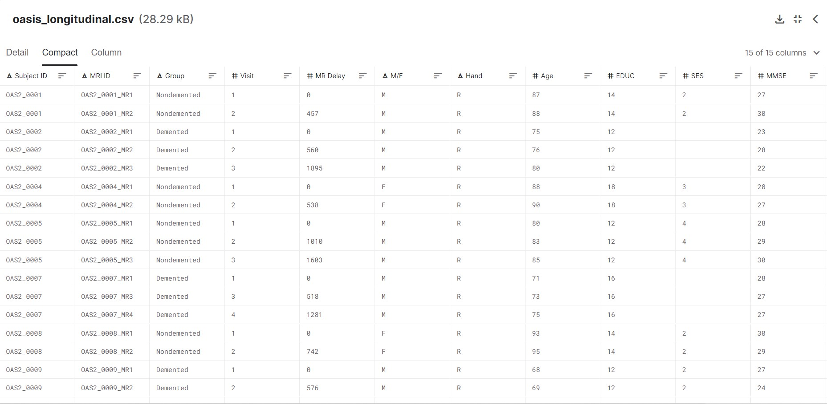
Dataset

Slide 7
Training the Model and Generating Predictions
1. Using Random Forest
#** Random Forest **
# Number of trees in random forest
n_estimators = range(10,250)
# Number of features to consider at every split
max_features = ['auto', 'sqrt']
# Maximum number of levels in tree
max_depth = range(1,40)
# Minimum number of samples required to split a node
min_samples_split = range(3,60)
# Create the random grid
parametro_rf = {'n_estimators': n_estimators,
'max_features': max_features,
'max_depth': max_depth,
'min_samples_split': min_samples_split}
model_forest = RandomForestClassifier(n_jobs=-1)
forest_random = RandomizedSearchCV(estimator = model_forest, param_distributions = parametro_rf, n_iter = 100, cv = FOLDS, verbose=1, random_state=42, n_jobs = -1, scoring='neg_mean_absolute_error')
forest_random.fit(X_train, y_train)
model_rf = forest_random.best_estimator_
Predicted_rf= model_rf.predict(X_test)

Slide 8
Training the Model and Generating Predictions
2. Using Extra Tree
#** Extra Tree **
# Number of trees in random forest
n_estimators = range(50,280)
# Maximum number of levels in tree
max_depth = range(1,40)
# Minimum number of samples required to split a node
min_samples_leaf = [3,4,5,6,7,8,9,10,15,20,30,40,50,60]
# Create the random grid
parametro_Et = {'n_estimators': n_estimators,
'max_depth': max_depth,
'min_samples_leaf': min_samples_leaf}
model_et = ExtraTreesClassifier(n_jobs=-1)
et_random = RandomizedSearchCV(estimator = model_et, param_distributions = parametro_rf, n_iter = 100, cv = FOLDS,
verbose=1, random_state=42, n_jobs = -1, scoring='roc_auc')
et_random.fit(X_train, y_train)
model_et = et_random.best_estimator_
Predicted_et = model_et.predict(X_test)

Slide 9
Training the Model and Generating Predictions
3. Using Ada Boost
#** AdaBoost **
n_estimators = range(10,200)
learning_rate = [0.0001, 0.001, 0.01, 0.1,0.2,0.3,0.4,0.5,0.6,0.7,0.8,0.9,0.95,1]
# Create the random grid
parametros_ada = {'n_estimators': n_estimators,
'learning_rate': learning_rate}
model_ada = AdaBoostClassifier()
ada_random = RandomizedSearchCV(estimator = model_ada, param_distributions = parametros_ada, n_iter = 100, cv = FOLDS,
verbose=1, random_state=42, n_jobs = -1, scoring='roc_auc')
ada_random.fit(X_train, y_train)
model_ada = ada_random.best_estimator_
Predicted_ada = model_ada.predict(X_test)

Slide 10
Training the Model and Generating Predictions
4. Using Gradient Boosting
#** Gradient Boosting **
parametros_gb = {
"loss":["deviance"],
"learning_rate": [0.01, 0.025, 0.005,0.5, 0.075, 0.1, 0.15, 0.2,0.3,0.8,0.9],
"min_samples_split": [0.01, 0.025, 0.005,0.4,0.5, 0.075, 0.1, 0.15, 0.2,0.3,0.8,0.9],
"min_samples_leaf": [1,2,3,5,8,10,15,20,40,50,55,60,65,70,80,85,90,100],
"max_depth":[3,5,8,10,15,20,25,30,40,50],
"max_features":["log2","sqrt"],
"criterion": ["friedman_mse", "mae"],
"subsample":[0.5, 0.618, 0.8, 0.85, 0.9, 0.95, 1.0],
"n_estimators":range(1,100)
}
model_gb= GradientBoostingClassifier()
gb_random = RandomizedSearchCV(estimator = model_gb, param_distributions = parametros_gb, n_iter = 100, cv = FOLDS, verbose=1, random_state=42, n_jobs = -1, scoring='roc_auc')
gb_random.fit(X_train, y_train)
model_gb = gb_random.best_estimator_
Predicted_gb = model_gb.predict(X_test)

Slide 11
Training the Model and Generating Predictions
5. Using Support Vector Machine
#** Support Vector **
C = [0.001, 0.10, 0.1, 10, 25, 50,65,70,80,90, 100, 1000,2000,10000,20000,25000,30000,40000]
kernel = ['rbf']
gamma =[1e-2, 1e-3, 1e-4, 1e-5,1e-6,1e-7,1e-8,1]
# Create the random grid
parametros_svm = {'C': C,
'gamma': gamma,
'kernel': kernel}
model_svm = SVC()
from sklearn.model_selection import GridSearchCV
svm_random = GridSearchCV(model_svm, parametros_svm, cv = 20, verbose=1, n_jobs = -1,scoring='roc_auc')
svm_random.fit(X, y)
model_svc = svm_random.best_estimator_
Predicted_svm= model_svc.predict(X_test)

Slide 12
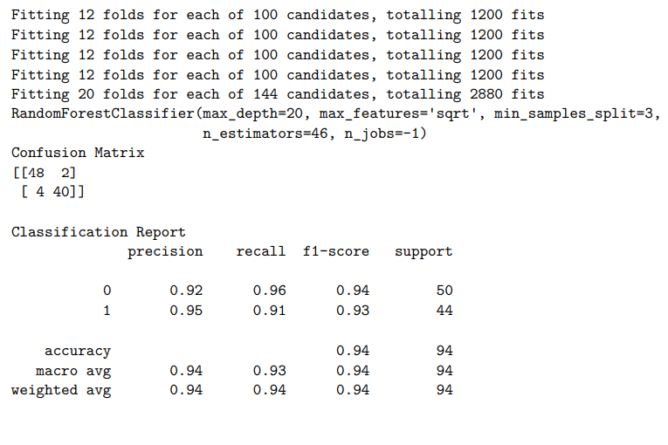
Performance Metrics for each Model
#**Random Forest **
acc=[]
model='Random Forest'
test_score = cross_val_score(model_rf, X_train, y_train, cv=FOLDS, scoring='accuracy').mean()
# Get recall for each parameter setting
test_recall = recall_score(y_test, Predicted_rf, pos_label=1)
fpr, tpr, thresholds = roc_curve(y_test, Predicted_rf, pos_label=1)
test_auc = auc(fpr, tpr)
acc.append([model,test_score, test_recall, test_auc, fpr, tpr, thresholds])

Slide 13
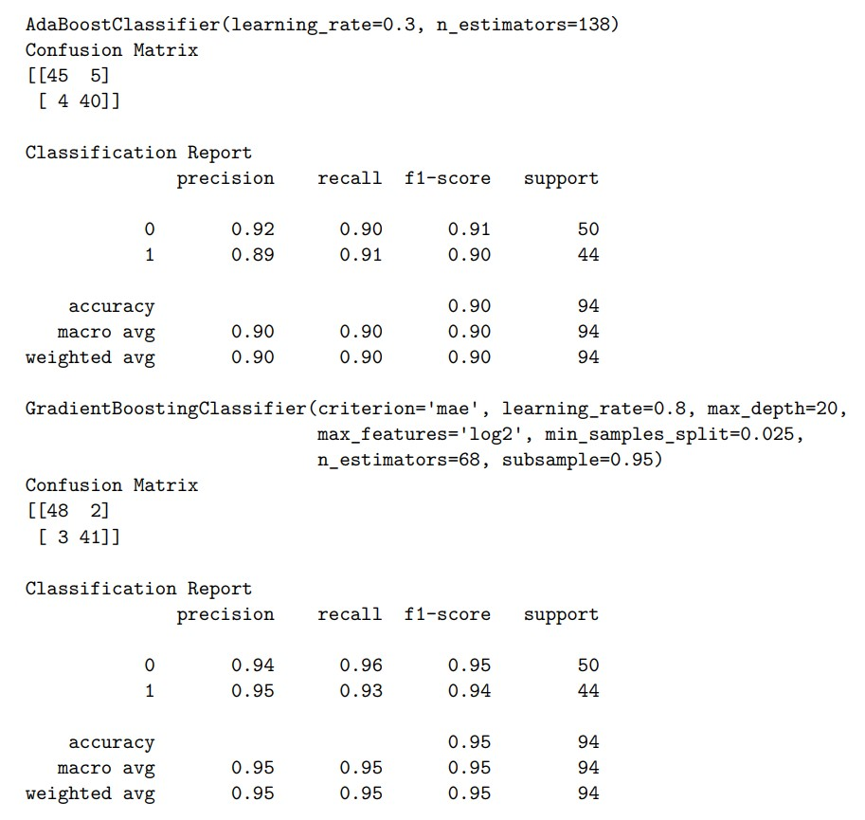
Performance Metrics for each Model
#*Ada Boost **
model='AdaBoost'
test_score = cross_val_score(model_ada, X_train, y_train, cv=FOLDS, scoring='accuracy').mean() # Get recall for each parameter setting
test_recall = recall_score(y_test, Predicted_ada, pos_label=1)
fpr, tpr, thresholds = roc_curve(y_test, Predicted_ada, pos_label=1)
test_auc = auc(fpr, tpr)
acc.append([model, test_score,test_recall, test_auc, fpr, tpr, thresholds])

Slide 14
Performance Metrics for each Model
#**Gradient Boosting **
model='Gradient Boosting'
test_score = cross_val_score(model_gb, X_train, y_train, cv=FOLDS, scoring='accuracy').mean() # Get recall for each parameter setting
test_recall = recall_score(y_test, Predicted_gb, pos_label=1)
fpr, tpr, thresholds = roc_curve(y_test, Predicted_gb, pos_label=1)
test_auc = auc(fpr, tpr)
acc.append([model, test_score,test_recall, test_auc, fpr, tpr, thresholds])

Slide 15
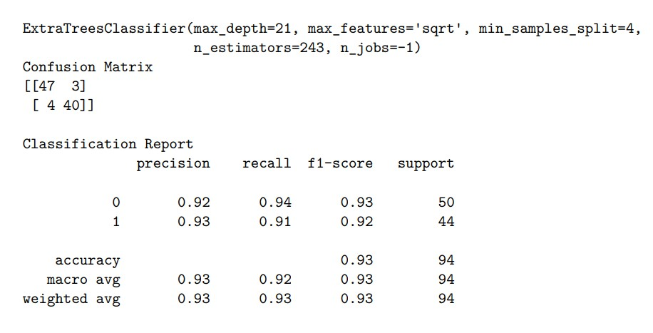
Performance Metrics for each Model
#** Extra Trees **
model='ExtraTrees'
test_score = cross_val_score(model_et, X_train, y_train, cv=FOLDS, scoring='accuracy').mean() # Get recall for each parameter setting
test_recall = recall_score(y_test, Predicted_et, pos_label=1)
fpr, tpr, thresholds = roc_curve(y_test, Predicted_et, pos_label=1)
test_auc = auc(fpr, tpr)
acc.append([model, test_score, test_recall, test_auc, fpr, tpr, thresholds])

Slide 16
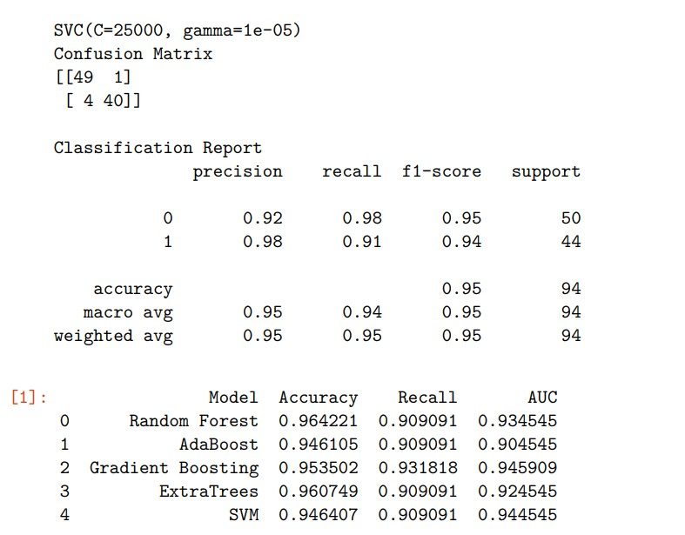
Performance Metrics for each Model
#** Support Vector Machine **
model='SVM'
test_score = cross_val_score(model_svc, X_train, y_train, cv=FOLDS, scoring='accuracy').mean() # Get recall for each parameter setting
test_recall = recall_score(y_test, Predicted_svm, pos_label=1)
fpr, tpr, thresholds = roc_curve(y_test, Predicted_svm, pos_label=1)
test_auc = auc(fpr, tpr)
acc.append([model, test_score, test_recall, test_auc, fpr, tpr, thresholds])

Slide 17
Report with summary for each Model
def report_performance(model):
model_test = model.predict(X_test.values)
print(model)
print("Confusion Matrix")
print("{0}".format(metrics.confusion_matrix(y_test,
model_test)))
print("")
print("Classification Report")
print(metrics.classification_report(y_test, model_test))
report_performance(model_rf)
report_performance(model_ada)
report_performance(model_gb)
report_performance(model_et)
report_performance(model_svc)
#** Results **
result = pd.DataFrame(acc, columns=['Model', 'Accuracy', 'Recall', 'AUC', 'FPR', 'TPR', 'TH'])
result[['Model', 'Accuracy', 'Recall', 'AUC']]

Slide 18
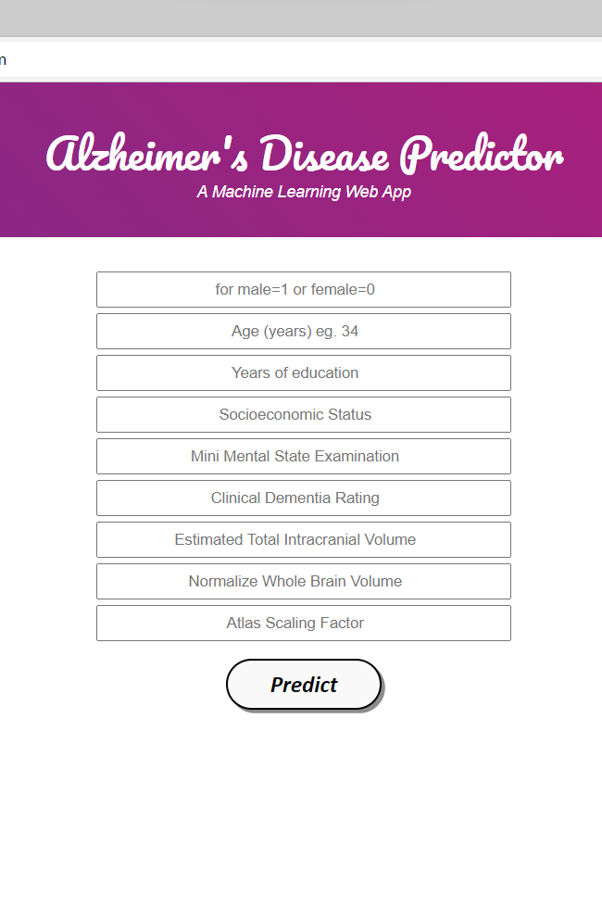
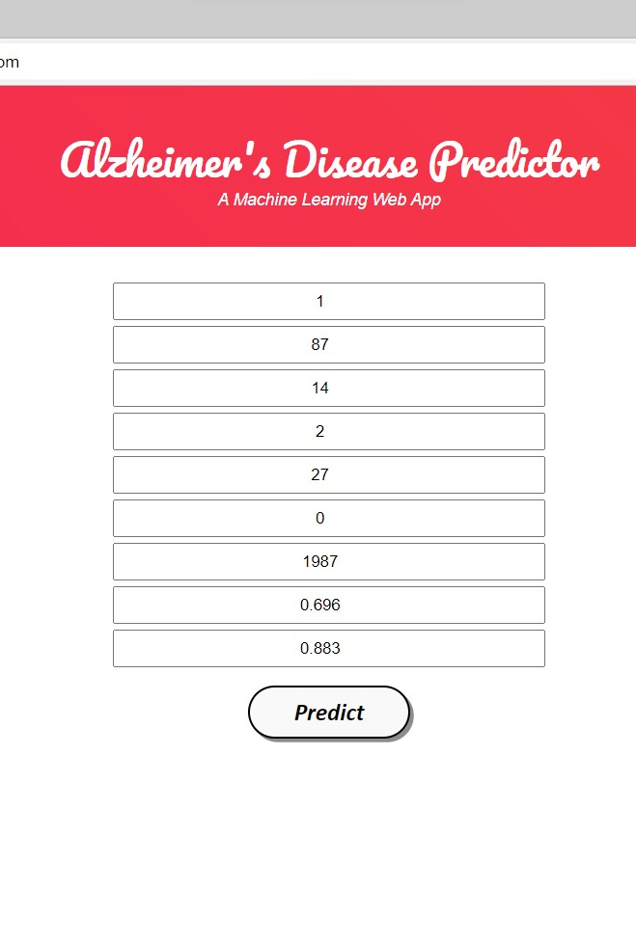
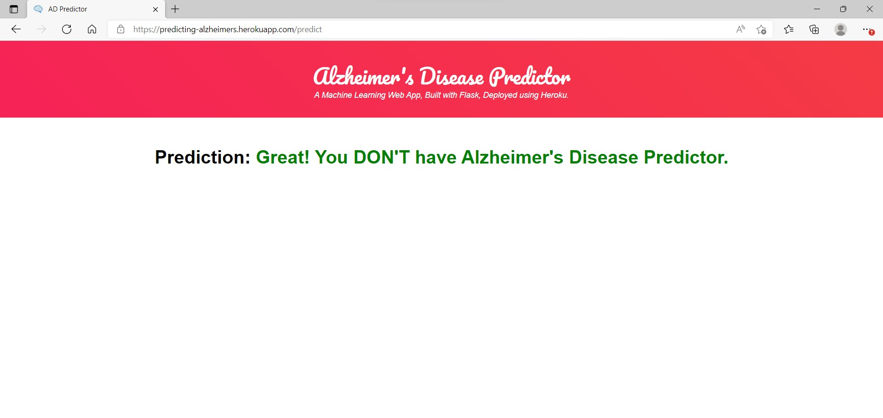
Execution with Results

Slide 19
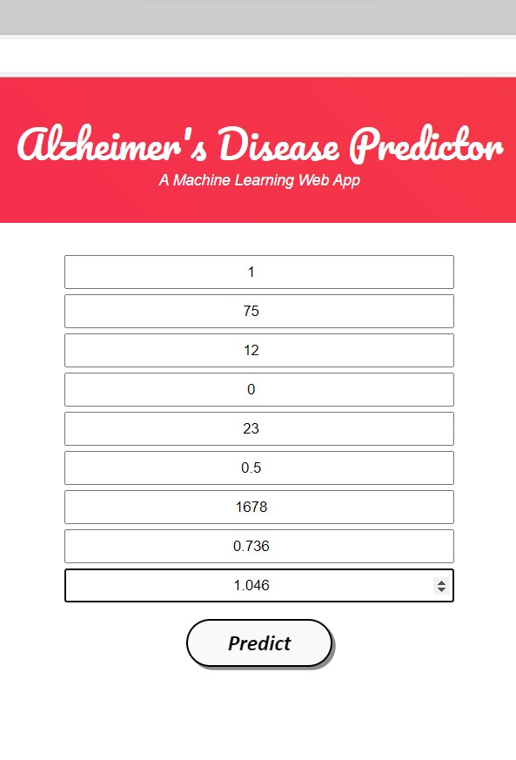
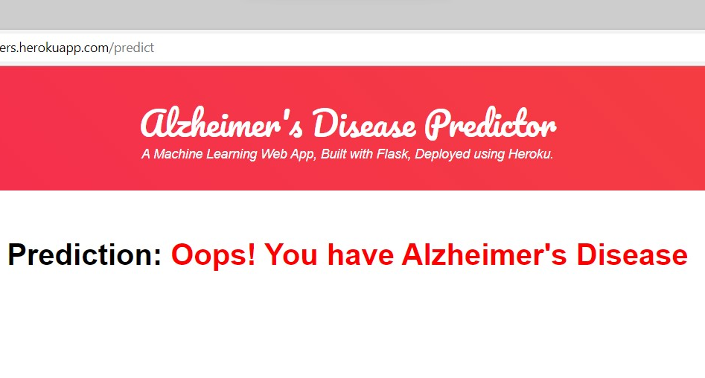
Execution with Results

Slide 20
Conclusion
The objective of this study is to evaluate the various aspects of machine learning in the prediction and prognosis of Alzheimer's disease. It is widely believed that machine learning can improve the prediction accuracy of statistical tools. However, this method did not achieve a 100% accurate diagnosis due to the lack of pathological verification. The proposed method aims to overcome the class imbalance and the overtraining issues by implementing a single modality. We believe that this method can improve the accuracy of the diagnosis. The proposed method can help improve the performance of the machine learning tools by covering the limitations that were identified in the previous research.

Slide 21
THANK YOU

